Slide 1
An Introduction to Prefetching
Csaba Andras Moritz
November, 2007
Copyright C A Moritz, Yao Guo, and SSA group
Notes:
First, what is prefetching? The objective is to bring data into the cache hierarchy BEFORE it’s needed by the application. Prefetching contrasts with DEMAND FETCHING, which is what happens when the CPU encounters a load instruction. When there’s a cache miss, then this demand fetch propagates down the hierarchy, and if the data is not in a cache, it must be retrieved from main memory. This can take a very long time.
The objective behind caching is to hang onto data accessed in the past because it’s likely to be used again. The objective behind prefetching is to look into the future and bring data in before it’s needed.
Without prefetching, performance can suffer due to cache misses. With good prefetching, many of those misses can be avoided. Prefetching will help avoid compulsory misses by looking ahead in time and conflict and capacity misses by again looking ahead working out what evicted data needs to be brought back into the cache.
To summarize: Prefetching predicts future cache misses and issues fetches to the memory system in advance of the actual memory reference. This hides memory access latency.

Slide 2
Outline
Introduction
Data Prefetching
  Array prefetching
  Pointer prefetching
Instruction Prefetching
Advanced Techniques
  Energy-aware prefetching
Summary

Slide 3
Why Prefetching?

Slide 4
“Memory Wall”
1000
“Moore’s Law”
CPU
100
Processor-Memory
Performance Gap:
(grows 50% / year)
Performance
10
DRAM
1
1980
1981
1982
1983
1984
1985
1986
1987
1988
1989
1990
1991
1992
1993
1994
1995
1996
1997
1998
1999
2000
Notes:
Caches help with this by avoiding memory access. By bringing data into the cache before it’s needed, prefteching doesn’t avoid long memory latencies, but we do avoid long memory stalls.

Slide 5
Hide the Memory Latency
Many techniques have been proposed to further hide/tolerate the increasing memory latency.
  For example
    Caches
    Locality optimization
    Pipelining
    Out-of-order execution
    Multithreading
Prefetching is one of the well studied techniques to hide memory latency.
  Some prefetching schemes have been adopted in commercial processors.
Notes:
By optimizing cache size, line size, and associativity, we can optimize cache hit rates on data accessed in the pass.
We can write software and organize data structures to play nice with cache structure. (e.g. combining arrays into structs, increasing spatial locality).
Pipelining – reorganized code so long latency instructions for a loop iteration occur in the previous iteration.
OOO – long latency memory instruction, the CPU can continue executing independent ones.
Multithreading allows one CPU pipeline to switch between independent threads as it encounters long latency memory instruction.
Here we’re going to talk about prefetching and techniques used to make predictions about what memory accesses are likely to occur in the future. Some very sophisticated prefetching mechanisms are used in modern CPUs.

Slide 6
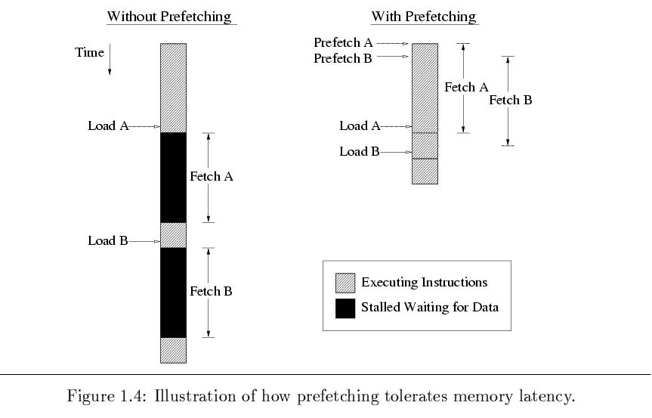
How Prefetching Works?
Notes:
Don’t worry. I’m going to tell you how it works. But first, let’s look at what effect pretching ideally will have.
If we have a really pretching algorithm that gets the cache warmed up in advance with the data we’re going to need, we may achieve the timeline on the right.

Slide 7
Prefetching Classification
Various prefetching techniques have been proposed.
  Instruction Prefetching vs. Data Prefetching
  Software-controlled prefetching vs. Hardware-controlled prefetching.
  Data prefetching for different structures in general purpose programs:
    Prefetching for array structures.
    Prefetching for pointer and linked data structures.
Notes:
A variety of prefetching techniques have been proposed.
Some are for instructions, some for data. As you know instructions are generally sequential, except for branches. So, a simple instruction prefetcher can simply keep fetching blindly ahead of the program counter, loading more instructions into the L1I cache. This will work well except for cases where it runs right past a branch, polluting the cache with instructions that won’t be executed. Works well for long stretches of instructions, but basic blocks average 8 instructions. Some branch predictors look ahead in the instruction cache and make predictions about branches before they’re fetched. These predictions can be fed to a prefetcher that begins loading the L1I cache with instructions from branch targets.
Prefetcing can be software controlled, where the programmer and/or compiler inserts explicit prefetch instructions. [profiling, building a trace of memory and judciously insert prfetches] We’ll see how this works well for loops. However, those prefetch instructions have overhead and only work well for loops, so many CPUs have hardware prefetchers that exmine data access patterns for regularity, and prefetch more data that fits the observed regular patterns.

Slide 8
Array Prefetching
Notes:
With array prefetching, we look for predictable array referencing patterns. A lot of scientific applications have loops over large arrays. Those access patterns have very poor cache locality (some spatial, no temporal), but they do have very predictable access patterns.

Slide 9
Examples
for (i=0; i<1000000000; i++) a[i] *= 1000;
for (i=0; i<1000000000; i++)
a[i*32] *= 1000;
Notes:
For each array element, there is one load, followed immediately by a store. Then it’s never accessed again.
For the first one, there is a bit of spatial locality due to caches fetching whole lines from main memory. But zero temporal locality.
For the second one, there is neither. Elements are spaced out so that each access is to its own line. There is no locality of reference at all.
However, both of these have completely regular access patterns. You can predict way far in advance exactly what addresses will be accessed.
This is what prefecthing is going to try to exploit.

Slide 10
Basic Questions
When to initiate prefetches?
  Timely
    Too early → replace other useful data (cache pollution) or be replaced before being used
    Too late → cannot hide processor stall
Where to place prefetched data?
  Cache or dedicated buffer
What to be prefetched?
Notes:
Too soon, prefetched data sits in cache unused for a long, potentially displacing data that needs to be used in the mean time. (This is another kind of pollution from what is caused by lines that are too long.) OR, the data that’s prefetched may get evicted due to some other demand fetch (regular load instruction) before it gets used. “Useless” prefetch
If the prefetch occurs too late, the CPU may still stall. Probably not as much as without prefetching at all, but we consider all stalls to be bad.
The prefetching algorithm needs to be careful about how far ahead of time it makes fetch requests.
Dedicated prefetch buffer – prefetched data goes into a queue and gets moved into cache on demand fetched.
What – how far ahead space do we prefetch.

Slide 11
Array Prefetching Approaches
Software-based
  Explicit “fetch” instructions
  Additional instructions executed
Hardware-based
  Special hardware
  Unnecessary prefetchings (w/o compile-time information)
Notes:
With software based prefetching algorithms, the compiler or programmer needs to insert instructions. These instructions take extra time that may reduce the benefits of prefetching. This also increases insruction cache pressure, meaning that any extra instructions will lead to more Icache misses.
Hardware prefetch doesn’t take up space in the instrution sequence, but it does require yet more hardware to be added to already very large CPUs. Plus, while software prefetching can be precise, hardware prefeching basically has to guess what’s going to happen next based on observing regular patterns. This leads to a fair amount of unnecessary prefetching, for instance, prefetches that happen in the last iteration of a loop. (Hw prefetch can’t know that)

Slide 12
Side Effects and Requirements
Side effects
  Prematurely prefetched blocks → possible “cache pollution”
  Removing processor stall cycles (increase memory request frequency);
  Unnecessary prefetchings → higher demand on memory bandwidth
Requirements
  Timely
  Useful
  Low overhead
Notes:
Kindof a recap of what we just talked about.
Prefetching blocks too early can make the cache hold data that is never going to be used or will displace data that needs to be used before the prefetched data is required.
Reduce CPU stall cycles, but also increase frequency of access to main memory. Even in cases where prefetching is essentially perfect, with fewer CPU stalls, later memory accesses that might be delayed will happen sooner. Basically, the program runs faster, to memory accesses occur more often.
However, predictors are imperfect, bringing in data that isn’t going to used, which further increases the demand on memory bandwidth.
Timely – just the right time in advance
Useful – Avoid prefetches of data that won’t be used
Low overhead – Prefertching should avoid interfering with normal execution due to increased instructions and demand on the memory system.

Slide 13
Software Data Prefetching
“fetch” instruction
  Non-blocking memory operation
  Cannot cause exceptions (e.g. page faults)
Modest hardware complexity
Challenge -- prefetch scheduling
  Placement of fetch inst relative to the matching load or store inst
  Hand-coded by programmer or automated by compiler
Notes:
It needs to be that fetch instructions can be issued speculatively wtihout causing any problems like a crash.

Slide 14
Loop-based Prefetching
Loops of large array calculations
  Common in scientific codes
  Poor cache utilization
  Predictable array referencing patterns
fetch instructions can be placed inside loop bodies s.t. current iteration prefetches data for a future iteration

Slide 15
Example: Vector Product
No prefetching
for (i = 0; i < N; i++) {
sum += a[i]*b[i];
}
Assume each cache block holds 4 elements
→ 2 misses/4 iterations
Simple prefetching
for (i = 0; i < N; i++) {
fetch (&a[i+1]);
fetch (&b[i+1]);
sum += a[i]*b[i];
}
Problem
  Unnecessary prefetch operations
Notes:
Each array element is 4 bytes, so 16-byte lines. On a miss, we get four words for a and another miss four for b.
Problem is that we’re going to make four times as many prefetches as we need, because we only need to prefetch once per line. Those prefetches take time, and will cut into the benefits of doing the prefetching.
So, how might we fix this problem? Loop unrolling.

Slide 16
Example: Vector Product (Cont.)
fetch (&sum);
fetch (&a[0]);
fetch (&b[0]);
for (i = 0; i < N-4; i+=4) {
fetch (&a[i+4]);
fetch (&b[i+4]);
sum += a[i]*b[i];
sum += a[i+1]*b[i+1];
sum += a[i+2]*b[i+2];
sum += a[i+3]*b[i+3];
}
for (i = N-4; i < N; i++)
sum = sum + a[i]*b[i];
Prefetching + loop unrolling
for (i = 0; i < N; i+=4) {
fetch (&a[i+4]);
fetch (&b[i+4]);
sum += a[i]*b[i];
sum += a[i+1]*b[i+1];
sum += a[i+2]*b[i+2];
sum += a[i+3]*b[i+3];
}
Problem
  First and last iterations
Notes:
Inserted fetch instuctions for the first elements for the next iterations.
Don’t get any prefetches for first iteration and extra ones for the end.

Slide 17
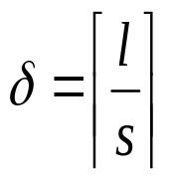
Example: Vector Product (Cont.)
Previous assumption: prefetching 1 iteration ahead is sufficient to hide the memory latency
When loops contain small computational bodies, it may be necessary to initiate prefetches d iterations before the data is referenced
d: prefetch distance, l: avg memory latency, s is the estimated cycle time of the shortest possible execution path through one loop iteration
fetch (&sum);
for (i = 0; i < 12; i += 4){
  fetch (&a[i]);
  fetch (&b[i]);
}
for (i = 0; i < N-12; i += 4){
  fetch(&a[i+12]);
  fetch(&b[i+12]);
  sum = sum + a[i] *b[i];
  sum = sum + a[i+1]*b[i+1];
  sum = sum + a[i+2]*b[i+2];
  sum = sum + a[i+3]*b[i+3];
}
for (i = N-12; i < N; i++)
sum = sum + a[i]*b[i];
Notes:
Assumed that one iteration ahead is enough. Not necessarily true.
Small loop bodies, then the memory latency may exceed the time it takes for the fetch to complete, so when we get corresponding demand fetches, the CPU still has to stall.
Delta – units of loop iterations
Average MISS latency
Conservative computation, based on shortest loop and rounding up. More conservative to use max miss latency, but that’s almost guarnteed to bring data into the cache too soon.
Example: Average miss latency = 100 cycles. Loop iteartion time = 45. Divide and round up, d = 3.
One loop iteration processes one cache line (of a and of b, in this case, but may not always be true), we need to prefetch three iterations, which is three cache lines in advance.
Epilogue – prefetching is 12 words ahead, so the last loop iteratves over 12 pairs of elements, benefitting from the last few prefetches in the main body.

Slide 18
Limitation of Software-based Prefetching
Normally restricted to loops with array accesses
Hard for general applications with irregular access patterns
Processor execution overhead
Significant code expansion
Performed statically
Notes:
Static – can’t adapt to unexpected changes in memory access patterns, even if they’re regular.
Fetch execition overhead – If every load has a fetch, then either the address will get computed twice, or the address computed for the fetch is stored in a register, which takes up space that could be used for other intermediate calculations, resulting in register spills to memory. Either way, fetches have computation overhead that can impact program performance.

Slide 19
Hardware Data Prefetching
No need for programmer or compiler intervention
No changes to existing executables
Take advantage of run-time information
E.g.,
  Alpha 21064 fetches 2 blocks on a miss
  Extra block placed in “stream buffer”
  On miss check stream buffer
Works with data blocks too:
  Jouppi [1990] 1 data stream buffer got 25% misses from 4KB cache; 4 streams got 43%
  Palacharla & Kessler [1994] for scientific programs for 8 streams got 50% to 70% of misses from
  2 64KB, 4-way set associative caches
Notes:
Let’s talk about various types of hardware prefetching.
In the alpha, whenever there was a miss, it would fetch two lines. Not the same as just making the cache line bigger. Each line is treated separately for placement and eviction decisions.
But to prevent the second line from polluting the cache, it’s put into a temporary buffer, which is checked on misses.

Slide 20
Sequential Prefetching
Take advantage of spatial locality
One block lookahead (OBL) approach
  Initiate a prefetch for block b+1 when block b is accessed
  Prefetch-on-miss
    Whenever an access for block b results in a cache miss
  Tagged prefetch
    Associates a tag bit with every memory block
    When a block is demand-fetched or a prefetched block is referenced for the first time next block is fetched.
    Used in HP PA7200
Notes:
The first type of hardware prefetrching we’ll talk about is sequential prefetching. This looks ahead linearly in memory.
There are two main approaches to this.
Tagged prefetch – when a block b is demand fetched, then b+1 is prefetched. And when a prefertched block is accessed for the first time, the next one is prefeteched.

Slide 21
OBL Approaches
Prefetch-on-miss
Tagged prefetch
demand-fetched
0
demand-fetched
prefetched
1
prefetched
demand-fetched
prefetched
0
demand-fetched
0
prefetched
1
prefetched
Notes:
These represent lines in memory being accessed in sequential order.

Slide 22
Degree of Prefetching
OBL may not initiate prefetch far enough to avoid processor memory stall
Prefetch K > 1 subsequent blocks
  Additional traffic and cache pollution
Adaptive sequential prefetching
  Vary the value of K during program execution
  High spatial locality → large K value
  Prefetch efficiency metric
  Periodically calculated
  Ratio of useful prefetches to total prefetches
Notes:
Fetching one block ahead may not look ahead far enough to avoid stalls. Perhaps what we want to do is ensure that more than one block ahead of the one being accessed is prefetched.
Variable K here is the degree of prefetching which is how far ahead of the current demand fetches the cache will prefetch. Again, ahead here is just the next lines in the memory space, like taking the address of the current load instruction and adding a constant to that address.
K recalculated as a function of the degree of spatial locality characteristics of the program.
Prefetch efficiency – ratio of useful prefetches to total
K init to 1
Incremented when efficiency exceeds a threshold
Decremented when efficiency drops below another threshold
K can be reduced to zero, disabling prefetch for loads with poor spatial locality.

Slide 23
Stream Buffer
K prefetched blocks → FIFO stream buffer
As each buffer entry is referenced
  Move it to cache
  Prefetch a new block to stream buffer
Avoid cache pollution
Notes:
Talked about where to put prefetch data. Could go into the cache. Or we can put it into a stream buffer that is looked at on misses.
The stream buffer assumes sequential memory accesses. When there’s a cache miss that is a hit on the head of the queue, then the line is moved from the queue to the cache, and then another line further down in memory is loaded into the tail of the queue.

Slide 24
Stream Buffer Diagram
from processor
to processor
Tags
Data
Direct
mapped
cache
head
tag and
comp
one cache block of data
Stream
buffer
a
tag
one cache block of data
a
tail
tag
one cache block of data
a
Source: Jouppi
ICS’90
tag
one cache block of data
a
+1
Shown with a single stream buffer (way); multiple ways and filter may be used
next level of cache
Notes:
If there is a hit in the cache, that is processed normally.
If there’s a miss in the cache and a hit at the head of the stream buffer, then the line is moved into the cache, and the queue advances, pulling in another new line at the tail.
If there’s a miss in both, then the stream buffer is flushed, because the system assumes that a new, unrelated sequential access pattern is about to start.

Slide 25
Sequential Prefetching
Pros:
  No changes to executables
  Simple hardware
Cons:
  Only applies for good spatial locality
  Works poorly for nonsequential accesses
  Unnecessary prefetches for scalars and array accesses with large stride
Notes:
Although you might want to optimize an applications access patterns to cooperate better with the way the prefetcher works. So ensuring there are more sequential patterns.
Good spatial locality, in particular, forward moving sequential access.

Slide 26
Examples
for (i=0; i<1000000000; i++) a[i] *= 1000;
for (i=0; i<1000000000; i++)
a[i*32] *= 1000;
Notes:
For each array element, there is one load, followed immediately by a store. Then it’s never accessed again.
For the first one, there is a bit of spatial locality due to caches fetching whole lines from main memory. But zero temporal locality.
For the second one, there is neither. Elements are spaced out so that each access is to its own line. There is no locality of reference at all.
However, both of these have completely regular access patterns. You can predict way far in advance exactly what addresses will be accessed.
This is what prefecthing is going to try to exploit.

Slide 27
Prefetching with Arbitrary Strides
Employ special logic to monitor the processor’s address referencing pattern
Detect constant stride array references originating from looping structures
Compare successive addresses used by load or store instructions
Notes:
Constant stride – the distance between consecutive accesses is a constant.
The hardware will detect this and begin automatically prefetching in a manner consistent with that stride.
Compare addresses, subtract to get distances, and use those same distances to guess the next addresses that will be accessed.

Slide 28
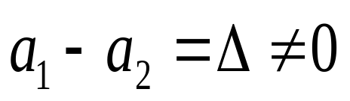
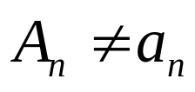
Basic Idea
Assume a memory instruction, m_{i}, references addresses a₁, a₂ and a₃ during three successive loop iterations
Prefetching for m_{i} will be initiated if

Δ: assumed stride of a series of array accesses
The first prefetch address (prediction for a₃)
a₃ = a₂ + Δ
Prefetching continues in this way until
Notes:
One key thing that the CPU does is look at particular memory references. Most prefetchers won’t compare different loads and stores to each other. For a given memory instruction mi, the prefetcher is going to compare the addresses used by THAT instruction.
In a table indexed by the PC addresses of memory instructions, we’re going to store two things. One is the address accessed last time, and the other is the delta computed last time. They start out initialized to zero.
As a simplification, on the first access to a1, we’ll have a zero delta and no previous address, so no prefetch. On the second access to a2, we’ll have a previous address but no delta, so no prefetch, but the delta gets computed. At that point, we have both a previous address, a2, and a delta, so the CPU can predict a3 by adding the delta to a2.
[stopped here Dec 3]

Slide 29
Reference Prediction Table (RPT)
Hold information for the most recently used memory instructions to predict their access pattern
  Address of the memory instruction
  Previous address accessed by the instruction
  Stride value
  State field
Notes:
State helps it keep track of whether or not to do a prefetch.

Slide 30
Organization of RPT
PC
effective address
-
instruction tag
previous address
stride
state
+
prefetch address
Notes:
Initial – First occurrence of load, stride set to zero
Transient – Second occurrence, current stride doesn’t match previous (whenever current addr – prev != stride)
Steady – Subsequent occurrences when stride is consistent (start making predicitons)

Slide 31
Initial – First occurrence of load instruction
  Stride gets set to zero
Transient – Second occurrence (or whenever addr-prev != stride)
Steady – Subsequent occurrences (and when addr-prev == stride)
  Make predictions and generate prefetch requests

Slide 32
Example
float a[100][100], b[100][100], c[100][100];
...
for (i = 0; i < 100; i++)
for (j = 0; j < 100; j++)
for (k = 0; k < 100; k++)
a[i][j] += b[i][k] * c[k][j];
instruction tag
previous address
stride
state
ld b[i][k]
ld b[i][k]
ld b[i][k]
50000
50004
50008
4
4
0
initial
trans
steady
ld c[k][j]
ld c[k][j]
ld c[k][j]
90000
90400
90800
400
400
0
initial
trans
steady
ld a[i][j]
ld a[i][j]
ld a[i][j]
10000
10000
10000
0
0
0
initial
steady
steady
Notes:
Here’s a snapshot of the reference prediction table after a loop has been running for a while.
Predict future addresses and do prefetches as a function of the previous address plus the stride times a constant.
Stopped here Nov 30, 2015

Slide 33
Software vs. Hardware Prefetching
Software
  Compile-time analysis, schedule fetch instructions within user program
Hardware
  Run-time analysis w/o any compiler or user support
Integration
  e.g. compiler calculates degree of prefetching (K) for a particular reference stream and pass it on to the prefetch hardware.
Notes:
Let’s compare hardware and software prefetching
Each approach can catch useful predictions the other will miss. SW will be more accurate but more conservative.
K is how far in memory or the number of lines ahead the prefetcher will go in predicting future cache misses.

Slide 34
Integrated Approaches
Gornish and Veidenbaum 1994
  Prefetching Degree is calculated during compile time.
Zhang and Torrellas 1995
  Compiler generated tags indicate array or pointer structures
  Actual prefetching handled at hardware level
Notes:
Zhang – compiler tags pointers in data structures (like left and right pointers in a binary tree). When a data structure is accessed, the CPU can see these hints and will prefetch memory at all of the pointers in that data structure.

Slide 35
Integrated Approaches – cont.
Prefetch Engine – Chen 1995
  Compiler-feeds tag, address and stride information.
  Otherwise, similar to RPT.
Benefits of integrated approaches:
  small instruction overhead
  fewer unnecessary prefetches
Notes:
Chen – instead of the CPU inferring tags, addresses, and strides, these are provided by the compiler, but otherwise, predictions are made similarly to the RPT we saw before.

Slide 36
Summary – array prefetching
When are prefetches initiated?
  explicit fetch operation (instruction)
  monitoring referencing patterns
Where are prefetched data placed?
  normal cache - binding
  dedicated buffers
What is prefetched?
  Amount of data fetched
  Normally cache blocks

Slide 37
Pointer Prefetching

Slide 38
Prefetching Pointers – Software Approach
Mikko Lipasti ...(Micro’95) - SPAID
Luk & Mowry (TC’99) – Greedy Prefetch
Roth & Sohi (ISCA’99) – Jump Pointers
Chilimbi & Hitzel (PLDI’02) - Hot data Stream
Wu (PLDI’02) – Stride prefetching
Luk (ICS’02) – Profile-based stride pref
Inagaki (PLDI’03) – Dynamic Preftching

Slide 39
Prefetching Pointers – Hardware Approach
Roth & Sohi (ASPLOS’98)
  Dependent based
Cooksey ... (ASPLOS’02)
  Content-directed prefetching
Collins...Tullsen (Micro’02)
  Pointer cache assisted prefetching

Slide 40
Hardware vs. Software Approach
Hardware
Perform. cost: low
Memory traffic: high
History-directed
  could be less effective
Using profiling info.
Software
Perform. cost: high
Memory traffic: low
Better Improvement
Use human knowledge
  inserted by hand

Slide 41
SPAID: (Lipasti Micro’95).
Pointer- and Call-Intensive Programs.
Premise:
  Pointer arguments passed on procedure calls are highly likely to be dereferenced within the called procedure.
SPAID inserts prefetches at call sites for all the pointers passed as arguments.

Slide 42
Greedy Prefetching
Luk & Mowry’s work:
  Chi-Keung Luk and Todd C. Mowry. Compiler-based prefetching for recursive data structures. ASPLOS’96
  Chi-Keung Luk and Todd C. Mowry. Automatic compiler-inserted prefetching for pointer-based applications. IEEE TC’99
Prefetch all the pointers (children) when a node is visited.
  The neighbors have a good chance to be visited sometime in the future even only one pointer is used in traversal.
History-pointer prefetching
  similar to jump pointers

Slide 43
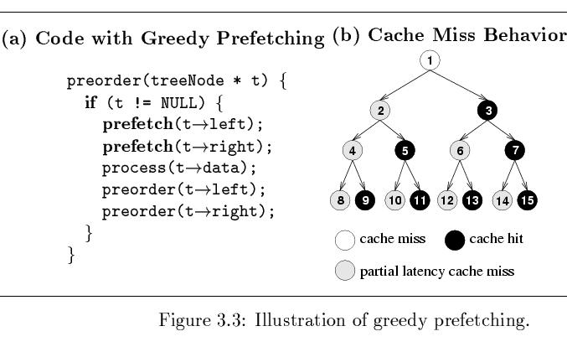
Greedy Prefetching - Example

Slide 44
Example #1
List Traversal
struct t{
stuct t *next,
data value} *p;
while(...){
work(p->data);
p = p->next;
prefetch(p->next);
}

Slide 45
Example #2
Tree traversal
struct t{
stuct t *left,*right;
data value} *p;
foo(struct t *p){
prefetch(p->left);
prefetch(p->right);
work(p->data);
foo(p->left);
foo(p->right);
}

Slide 46
Example #2 (cont.)
Tree traversal
foo(struct t *p){
work(p->data);
temp=p->left;
prefetch(temp->left);
prefetch(temp->right);
foo(temp);
temp=p->right;
prefetch(temp->left);
prefetch(temp->right);
foo(temp);
}

Slide 47
Energy-Aware Prefetching

Slide 48
Power Consumption
Sun’s Surface
10000
1000
Rocket Nozzle
Nuclear Reactor
100
Power Density (W/cm²)
8086
Hot Plate
10
8008
8085
Pentium®
Processors
4004
286
386
8080
486
1
1970
1980
1990
2000
2010
Source: Intel®

Slide 49
Power/Energy
Power consumption is a key constraint in processor designs
  Significant fraction in memory system
  Dynamic power & leakage power
Power/Energy reduction techniques:
  Circuit-level techniques
    CAM tags, asynchronous SRAM cells, word-line gating, etc
  Architecture-level techniques
    Sub-banking, voltage/frequency scaling, etc.
  Compiler-directed energy reduction
    Compiler-managed techniques to reduce switched load capacitances

Slide 50
Data Prefetching & Power/Energy
Most of the prefetching techniques are focused on improving the performance.
How does data prefetching affect power/energy consumption?
Power-consuming components
  Prefetching hardware
    Prefetch history tables
    Control logic
  Extra memory accesses
    Unnecessary prefetching?

Slide 51
Goals
Understand data prefetching and its implications on power/energy consumption.
  Understand performance/power tradeoffs
New energy-aware data prefetching solutions
Approaches
  Reduce unnecessary accesses to hardware
    Energy-aware prefetch filtering
  Improve the power efficiency of prefetch hardware
    Location-set driven data prefetching

Slide 52
Hardware Prefetching Techniques Studied
Prefetching-on-miss (POM)
  Basic sequential prefetching (One Block Lookahead).
Tagged Prefetching - a variation of POM.
  POM + Prefetch when previously prefetched blocks are accessed.
Stride Prefetching [Baer & Chen]
  Effective on array accesses with regular strides
Dependence-based Prefetching [Roth & Sohi]
  Based on relationships between pointers.
Combined Stride and Pointer Prefetching [new]
  Objective to evaluate a technique that would work for all types of memory access patterns

Slide 53
Prefetching Hardware Required
Prefetching Scheme | Hardware Required
Sequential | none
Tagged | 1 bit per cache line
Stride | A 64-entry Reference Prediction Table (RPT)
Dependence | A 64-entry Potential Producer Window (PPW) & a 64-entry Correlation Table (CT)
Combined | All three tables (RPT, PPW, CT)

Slide 54
Prefetching Energy Sources
Prefetching hardware:
  Data (history table) and control logic.
Extra tag-checks in L1 cache
  When a prefetch hits in L1 (no prefetch needed)
Extra memory accesses to L2 Cache
  Due to useless prefetches from L2 to L1.
Extra off-chip memory accesses
  When data cannot be found in the L2 Cache.
Notes:
From the procedure here, we can derive the sources of energy overhead from prefetching.
The first is the extra tag-checks in L1 cache, as we have seen, the L1 cache is checked
for every prefetching request from the prefetch engine before we do the actual prefetching.
We do not actually read the data from L1, the only thing we need is tag lookup.
depends on the different prefetching techniques,

Slide 55
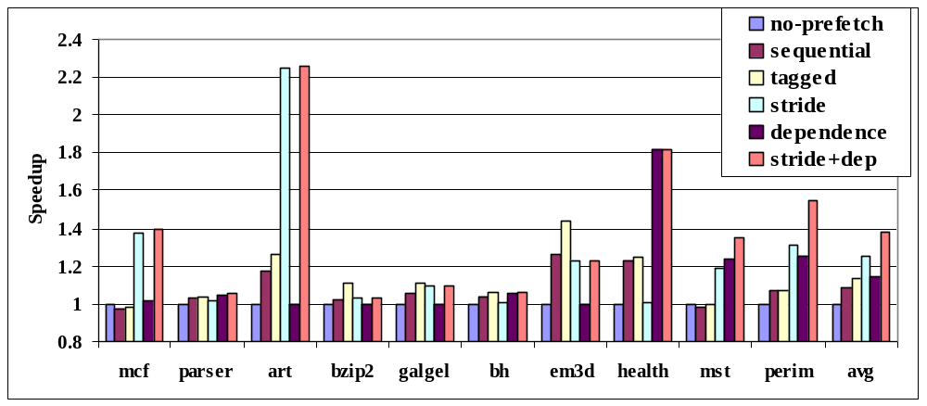
Performance Speedup
Combined (stride+dep) technique has the best speedup for most benchmarks.

Slide 56
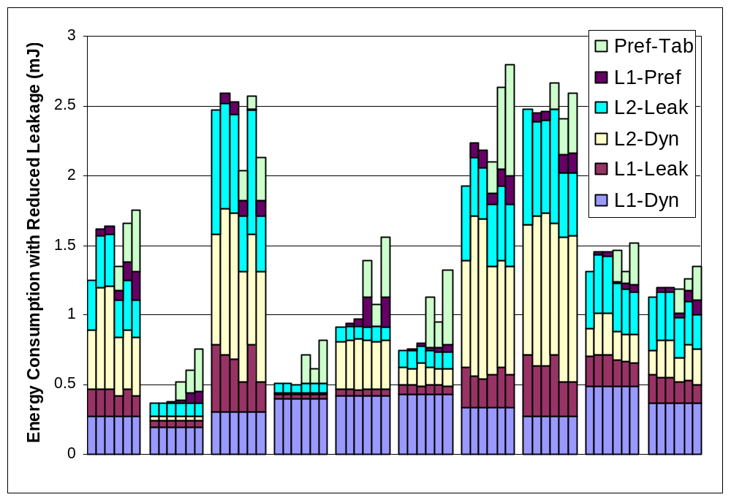
Prefetching Increases Energy!!
NoPrefetch
Sequential
Tagged
Stride
Dependence
Stride+Dep
mcf parser art bzip2 galgel bh em3d health mst perim

Slide 57
Energy-aware hardware prefetching
Energy overhead for hardware prefetching:
  Accesses to the prefetch hardware.
  Extra Tag checks in L1 cache.
Energy-aware hardware prefetching
  Energy-aware prefetch filtering: Reduce # of accesses to power-consuming components.
    Reduce accesses to prefetch history table
    Reduce extra tag checks in L1 cache
  Improve the power efficiency of the prefetch engine.
    Reduce load capacitance switched per prefetch access

Slide 58
Energy-Aware Prefetching Filtering
Compiler-Based Selective Filtering (CBSF)
  Only searching the prefetch hardware tables for selective memory instructions identified by the compiler.
Compiler-Assisted Adaptive Prefetching (CAAP)
  Selectively applying different prefetching schemes depending on predicted access patterns.
Compiler-driven Filtering using Stride Counter (SC)
  Reducing prefetching energy consumption wasted on memory access patterns with very small strides.
Hardware-based Filtering using PFB (PFB)
  Further reducing the L1 cache related energy overhead due to prefetching based on locality with prefetching addresses.

Slide 59
Power-Aware Prefetch Filtering
Compiler-Based Selective Filtering
LDQ RA RB OFFSET Hints
Regular
Cache Access
Filtered
Compiler-Assisted Adaptive Prefetching
Stride Counter
Filtered
Prefetch Filtering using Stride Counter
Stride
Prefetcher
Pointer
Prefetcher
Prefetching Filtering
Buffer (PFB)
Prefetches
Filtered
Tag-array
Data-array
Hardware Filtering using PFB
......
...
...
...
...
L1 D-cache
Prefetch from L2 Cache

Slide 60
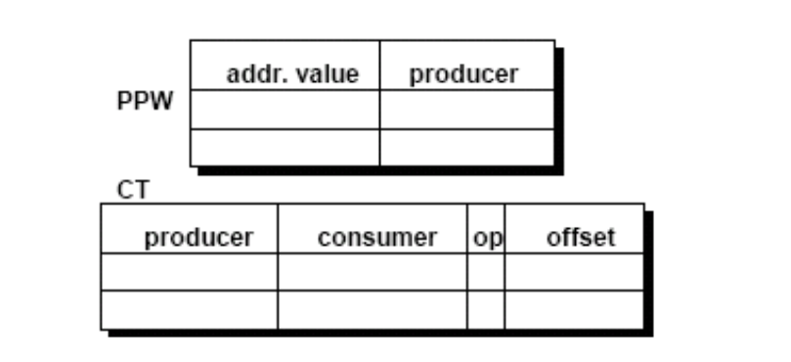
Dependence prefetching
Correlation between loads that produce and address and that consume an address (i.e., dependent) as opposed to same load.
  Linked data structures

Slide 61
Power Dissipation of Hardware Tables
The size of a typical history table is at least 64X64 bits, which is implemented as a fully-associative CAM table.
  Each prefetching access consumes more than 12 mW, which is higher than our low-power cache access.
  Low-power cache design techniques such as sub-banking don’t work.

Slide 62
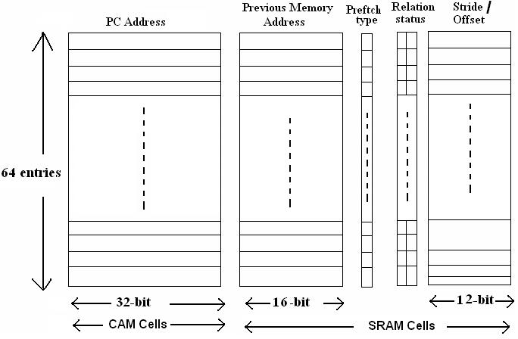
Original Prefetch History Table

Slide 63
How to Reduce Power Dissipation?
PARE - Power-Aware pRefetching Engine.
Two ways to reduce power:
  Reduces the size of each entry.
    Based on spatial locality of memory accesses.
  Partitions the large table into multiple smaller tables, like banking in caches, with compiler help.

Slide 64
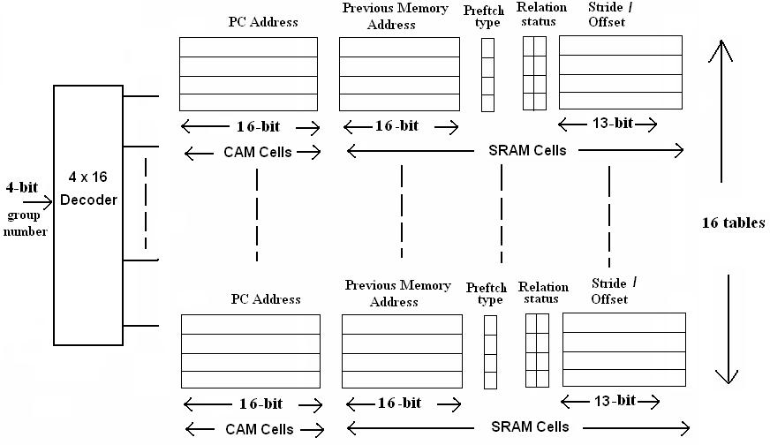
PARE Table Design Overview

Slide 65
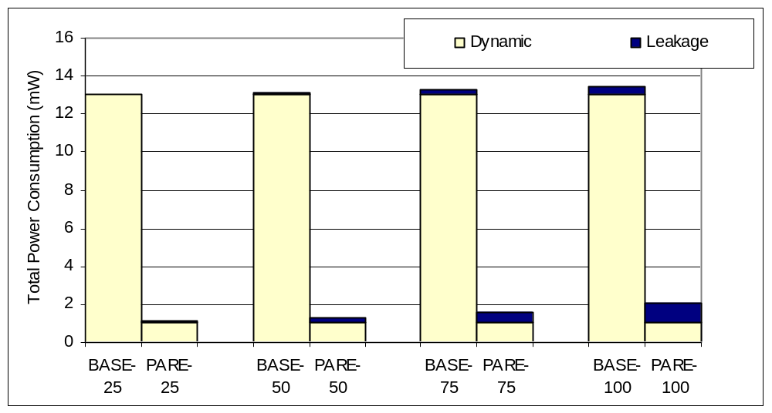
Power Optimization Results
Power is reduced by about 7-11X.
Temperature (C)

Slide 66
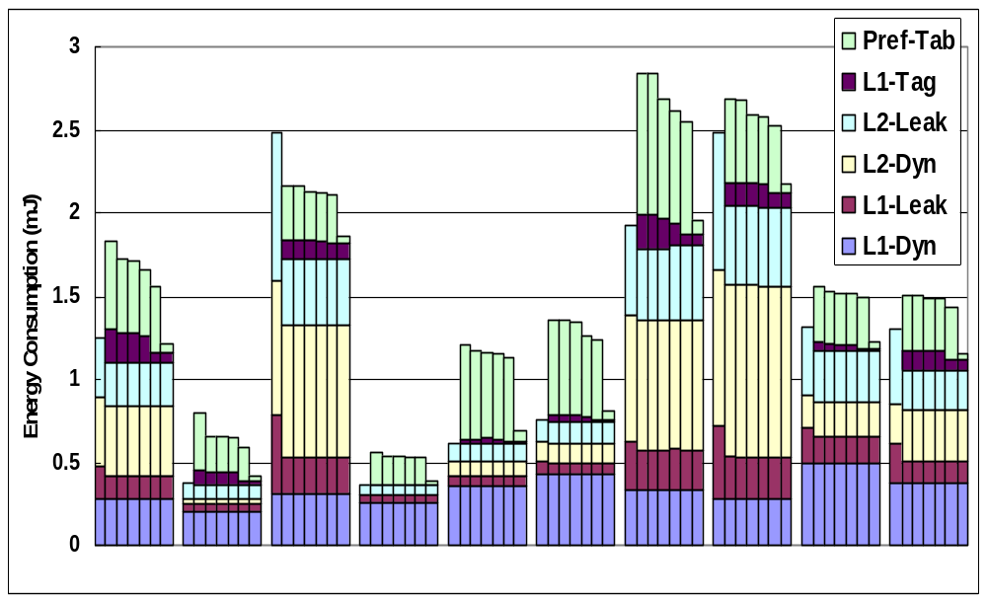
Energy-Saving Results - Combined
NoPrefetch
Stride+Dep
+ CBSF
+ CAAP
+ SC
+ PFB
+ PARE
mcf parser art bzip2 vpr bh em3d health mst perim

Slide 67
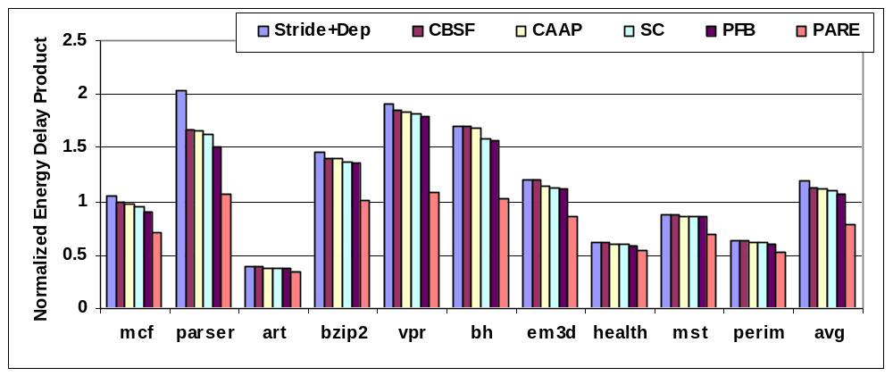
Energy-Delay Product
EDP is improved by 33% compared to the prefetching baseline and 25% compared to no prefetching.

Slide 68
Summary – Power-aware prefetching
Energy-aware data prefetching techniques
  Developed a set of energy-aware filtering techniques
    reduce the unnecessary energy-consuming accesses.
  Developed a location-set data prefetching technique
    uses power-efficient prefetching hardware: PARE.
Proposed techniques could overcome the energy overhead of data prefetching.
  Improve energy-delay product by 33% on average.
  Turn data prefetching into an energy saving technique
  as well as a performance improvement technique.

Slide 69
Backup Material
Instruction prefetching
Pointer prefetching
For energy-aware prefetching read Yao Guo et al papers

Slide 70
Instruction Prefetching

Slide 71
Instruction Prefetching
Next-N-line
  Each fetch also prefetches N sequential cache lines
Target-line
  Predict next line and prefetch it
Wrong-path
  Next-N-line combined with prefetching of lines targeted by static branches
Markov
  Use miss address prediction table to prefetch lines targeted by dynamic branches

Slide 72
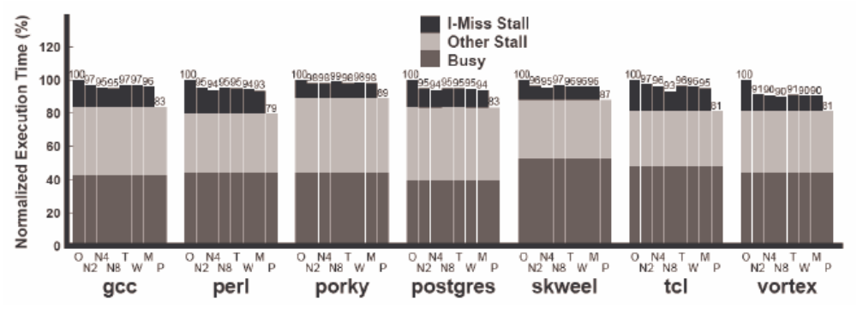
Hardware Prefetching Effectiveness
Why are these schemes not more effective?
Is that an inherent problem with hardware prefetching?

Slide 73
Hardware Mechanisms
Instruction-prefetch instructions
  Compiler provided hints allow prefetching
  Dropped after decode stage (does not ‘execute’)
Prefetch filtering
  Between I-prefetcher and L2 cache
  Reduces the number of useless prefetches
  L2 line counters increment for unused prefetches
  Prefetches are ignored for large counts

Slide 74
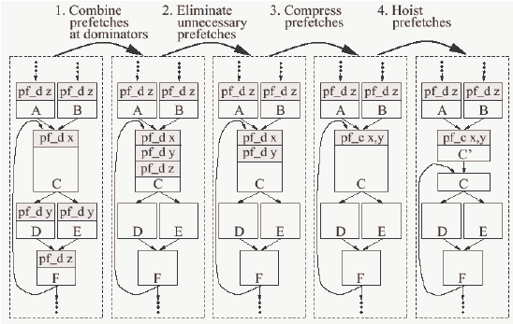
Compiler Support
-Luk & Mowry 12/98

Slide 75
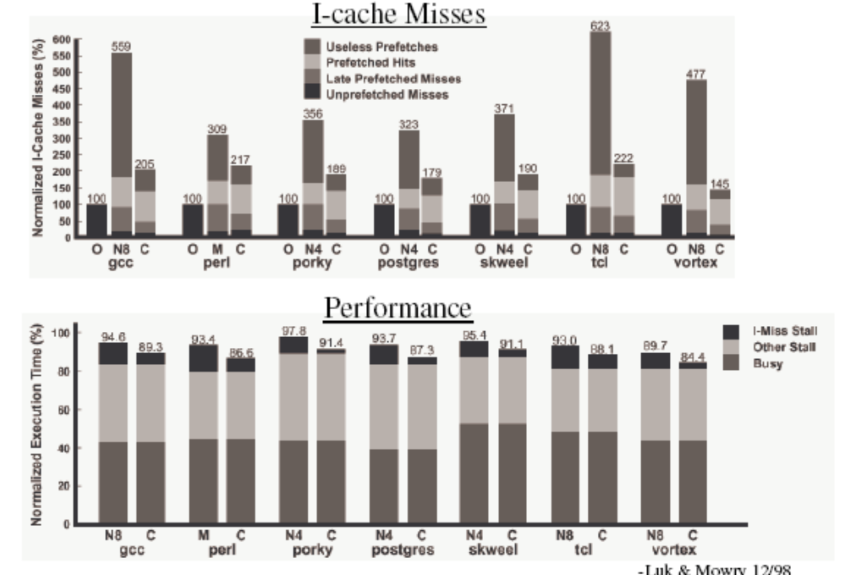
Results

Slide 76
More on pointer prefetching

Slide 77
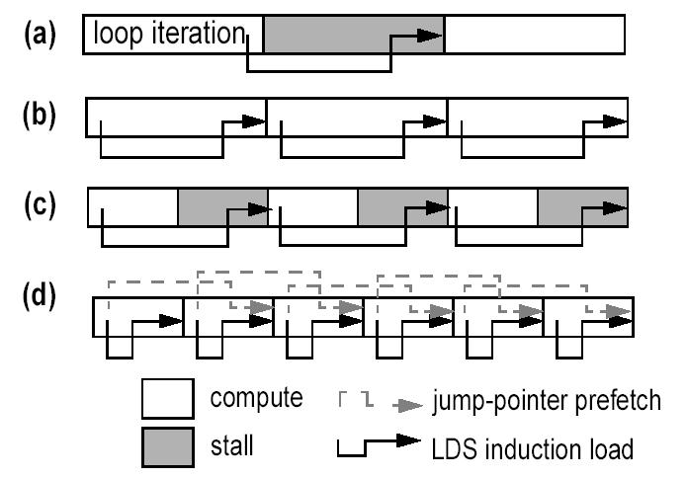
Jump Pointers – Roth’99

Slide 78
Jump Pointers – Roth’99
Jump Pointers are introduced to insert prefetches early enough to hide memory latency
  Profiling -> find hot spots
  Choose prefetch idiom by studying source code
  Insert the prefetching by hand
  Human work: one hour per bench (Olden)

Slide 79
Jump Pointers – Roth’99
Additional storage requirements
  History pointers are added into the data structure
  Could be offset by padding allocators
Code modification by hand
  Large programs?
No benefit from first traversal
  Installing/Creating jump pointers.

Slide 80
Hot Data Stream – Chilimbi’02
Hot Data Stream
  Data reference sequences that frequently repeat in the same order
  They account for around 90% of program references and more than 80% cache misses.
Hot data streams can be prefetched accurately since they repeat frequently in the same order.

Slide 81
Hot Data Stream – Chilimbi’02
Example:
  Given a hot data stream
  abacdce
  If we find a sequence of (prefix)
  aba
  Prefetches are inserted for
  c, d, e
  Deterministic finite state machine is used to do prefix-matching.

Slide 82
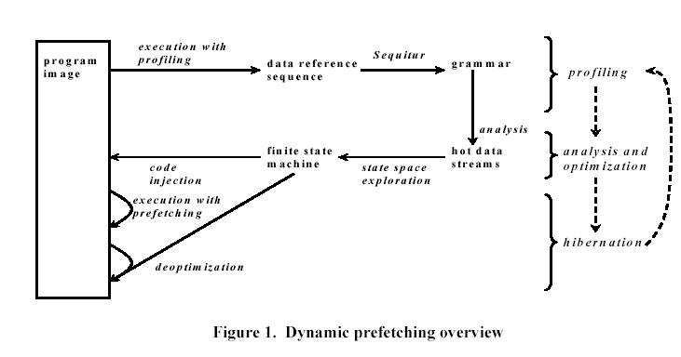
Hot Data Stream – Chilimbi’02

Slide 83
Stride Prefetching in Pointers
Discover regular stride patterns in irregular programs.
Y. Wu – PLDI’02, ICCC’02
Luk et. al. – ICS’02
  (Profiling based)
Inagaki et. al.– PLDI’03
  (Dynamic prefetching - Java)

Slide 84
Summary

Slide 85
Prefetching
Data Prefetching
  Prefetching for arrays vs. pointers
  Software-controlled vs. Hardware-controlled
Instruction Prefetching
Energy-Aware Prefetching

Slide 86
Prefetching in Other Areas
The idea of prefetching is widely used in other areas
  Internet: Web prefetching
  OS: Page prefetching, Disk prefetching
  Etc.

Slide 87
Reading Materials
Data prefetch mechanisms, Steven P. Vanderwiel, David J. Lilja, ACM Computing Surveys, Vol. 32 , Issue 2 (June 2000)

